Slide 1
Chapter 1
Introduction to Statistics and Data Analysis

Slide 2
1.1 – Overview of Statistics
Definition of Statistics that I like:
  The science of collecting, analyzing, and interpreting data.
While brief, I think this definition provides a good idea of the overarching goals in statistics.

Slide 3
1.1 – Overview of Statistics
A question for you:
  Why do we need data? Why is proper collection, analysis, and interpretation of data important?

Slide 4
1.1 – Overview of Statistics
To me, Statistics is the best tool we have to understand uncertainty. Being able to collect, analyze, and interpret data is essential in fields like Chemistry, Biology, Sociology, Psychology, Physics, Economics, and many others.
The proper application of statistical methods is crucial in most if not all of the steps of the scientific method.

Slide 5
1.1 – Overview of Statistics
Examples:
  Medicine – Drug testing
  Epidemiology – Lung cancer and smoking
  Cryptography – Alan Turing and Enigma
  Machine Learning – Self-driving cars, facial recognition
  Sports – Three point revolution in NBA

Slide 6
1.1 – Overview of Statistics
Generally, our goal in statistics is gather information from a sample and then generalize the results from the sample to some larger population of interest.
This is done by calculating statistics – numerical properties of the sample – and using them to estimate parameters – numerical properties of the population.
This process is called statistical inference and is illustrated in the next few slides.

Slide 7
Population

Slide 8
Population
Sample

Slide 9
Population
Parameters
Sample

Slide 10
Population
Parameters
Sample
Statistics

Slide 11
In practice, we rarely (if ever) know the true value of a parameter.
Population
Parameters
Sample
Statistics

Slide 12
In practice, we rarely (if ever) know the true value of a parameter.
Population
Parameters
Sample
Statistics
Statistics, on the other hand, can always be calculated based on the data we obtain from the sample.

Slide 13
In practice, we rarely (if ever) know the true value of a parameter.
Population
Parameters
Statistics, on the other hand, can always be calculated based on the data we obtain from the sample.
Sample
Statistics
The whole purpose of inference is to use the information we obtain from the sample to better understand the population. We use statistics (numerical summaries of the sample) to try to understand and estimate the parameters (numerical summaries of the population).

Slide 14
1.1 – Overview of Statistics
The part of the process where we actually make inferences back to the population relies heavily on probability theory.
This class is split into two main parts. In chapters 2-6, we focus on probability theory. Chapter 8 has more on probability, but it also sets the foundation for how we make inferences. Then chapters 9 and 10 focus on the two main tools of inference: estimation and significance testing.

Slide 15
1.2 – Collection of Data
While we will spend very little time on the proper collection of data, there are still a few important ideas to mention regarding how the data we use are obtained.
A main goal of data collection is to create a sample that is representative of the population. That is, we want the characteristics of the sample to be as similar as possible to the characteristics of the population.
Consider this example: We want to find out the average number of hours that UNL students spend in Love Library each week.

Slide 16
1.2 – Collection of Data
Suppose we decide that we need to sample 100 UNL students (we’ll talk in a later section about how to come up with an appropriate sample size ).
Now we need to determine which 100 UNL students to talk to. Is it a good idea to go stand outside of Love Library and talk to people who are going in until we have information from 100 students? Why or why not?

Slide 17
1.2 – Collection of Data
If we go to Love Library, our sampling method is biased towards those who actually go to Love Library.
Remember that we want to know the average number of hours spent in Love Library for all UNL students. With this sampling plan, we will never talk to students who don’t go to Love Library. We would also probably miss those who only occasionally or rarely go.

Slide 18
1.2 – Collection of Data
This is an example of convenience sampling. Convenience sampling usually leads to samples that are not representative of the population.
So what do we need to do instead? Use some form of random sampling. In order for a sampling method to be random, every unit in the population has to have the same probability of being selected for the sample.

Slide 19
1.2 – Collection of Data
Random sampling is often very difficult. But here’s the upside: random samples tend to produce samples that are representative. That is, if our sample is truly random, we can generalize the results from the sample to the population.

Slide 20
1.2 – Collection of Data
While entire classes can be taken on sampling methods, this is all we will mention for now.
Things for you to take away from this discussion:
  Convenience sampling leads to bad samples
  Definition of random sampling
  Reason why random sampling is important: allows us to generalize sample results back to the population.

Slide 21
Describing Data
We now move into looking at ways to describe data. Two of the things we are most interested in when looking at data are (1) where the data are centered and (2) how spread out the data are.
We will next look at each of these two ideas and finish the chapter by exploring a few ways to visualize data.

Slide 22
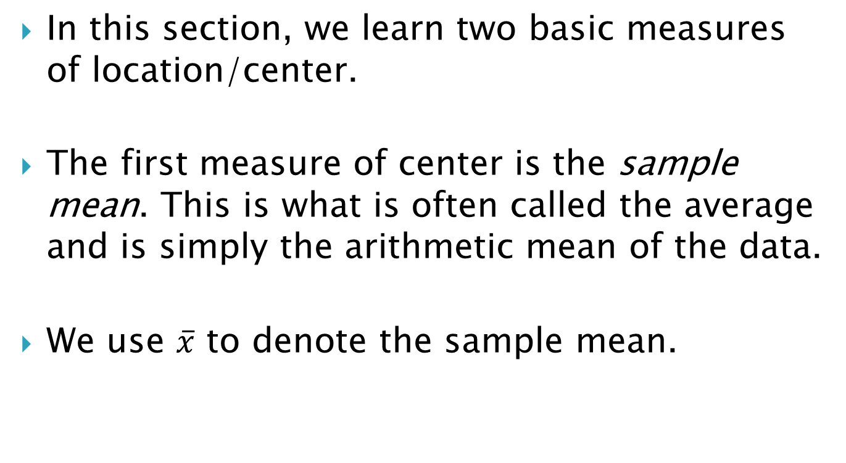
1.3 – Measures of Location
In this section, we learn two basic measures of location/center.
The first measure of center is the sample mean. This is what is often called the average and is simply the arithmetic mean of the data.
We use $\overline{x}$ to denote the sample mean.

Slide 23
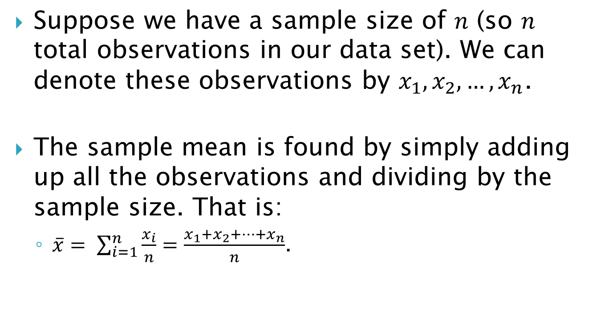
1.3 – Measures of Location
Suppose we have a sample size of $n$ (so $n$ total observations in our data set). We can denote these observations by $x_{1}, x_{2},…, x_{n}$.
The sample mean is found by simply adding up all the observations and dividing by the sample size. That is:
  $\overline{x}= \sum_{i=1}^{n}{\frac{x_{i}}{n}}=\frac{x_{1}+x_{2}+…+x_{n}}{n}$.

Slide 24

1.3 – Measures of Location
Suppose we have GPAs of 5 students: 4.0, 3.5, 3.61, 2.9, 3.87. Then we calculate the sample mean by $\overline{x}=\frac{4+3.5+3.61+2.9+3.87}{5}=3.576$. That is, the average GPA for these 5 students is 3.576.

Slide 25
1.3 – Measures of Location
The sample mean is commonly used because (1) it is easy to work with and (2) is usually a good measure of center.
One situation where the sample mean is not a good measure of center is when outliers are present in the data (outliers are observations that do not fit the overall pattern of the data). In such a case, it is often preferable to use the sample median instead of the sample mean.

Slide 26
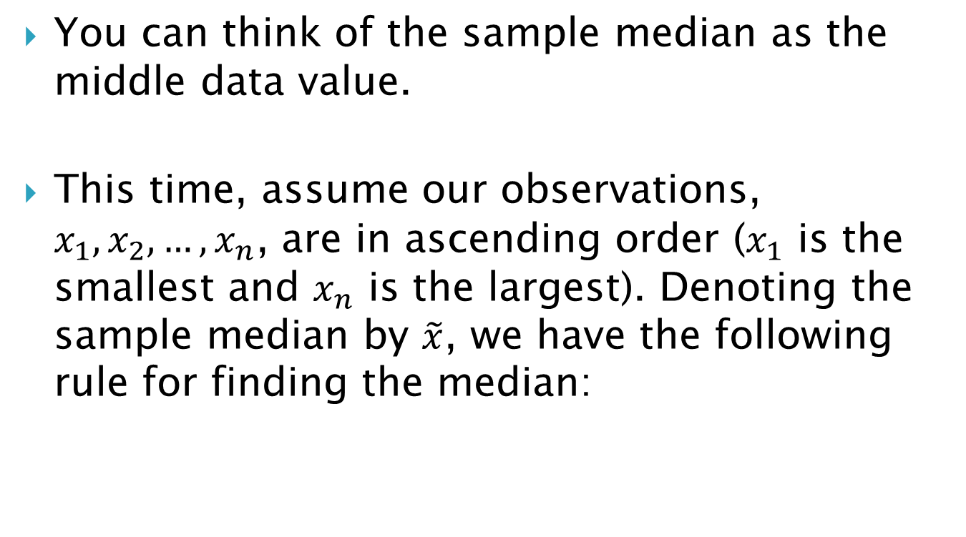
1.3 – Measures of Location
You can think of the sample median as the middle data value.
This time, assume our observations, $x_{1}, x_{2},…, x_{n}$, are in ascending order ($x_{1}$ is the smallest and $x_{n}$ is the largest). Denoting the sample median by $\tilde{x}$, we have the following rule for finding the median:

Slide 27
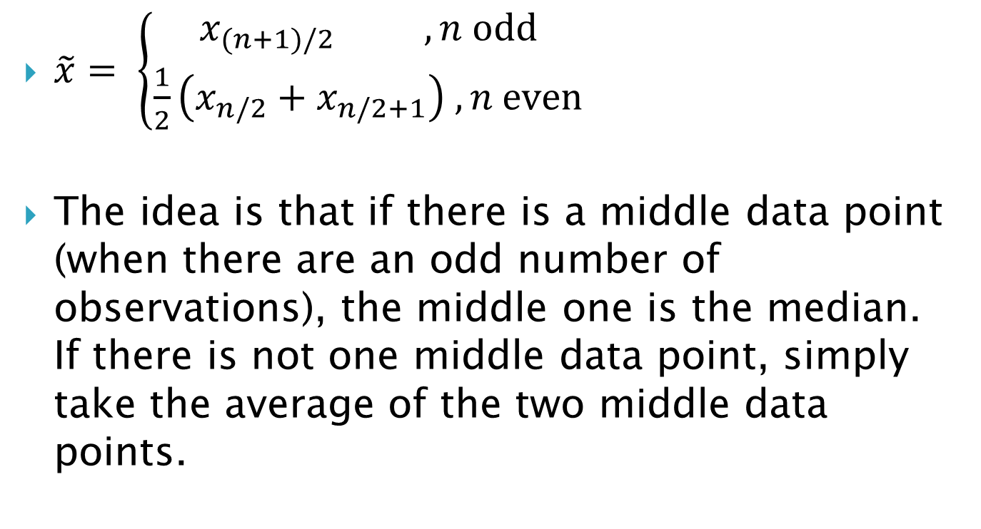
1.3 – Measures of Location
$\tilde{x}= \left\{\begin{aligned}x_{(n+1)/2} , n odd \\ \frac{1}{2}\left(x_{n/2}+x_{n/2+1}\right) , n even\end{aligned} \right.$
The idea is that if there is a middle data point (when there are an odd number of observations), the middle one is the median. If there is not one middle data point, simply take the average of the two middle data points.

Slide 28
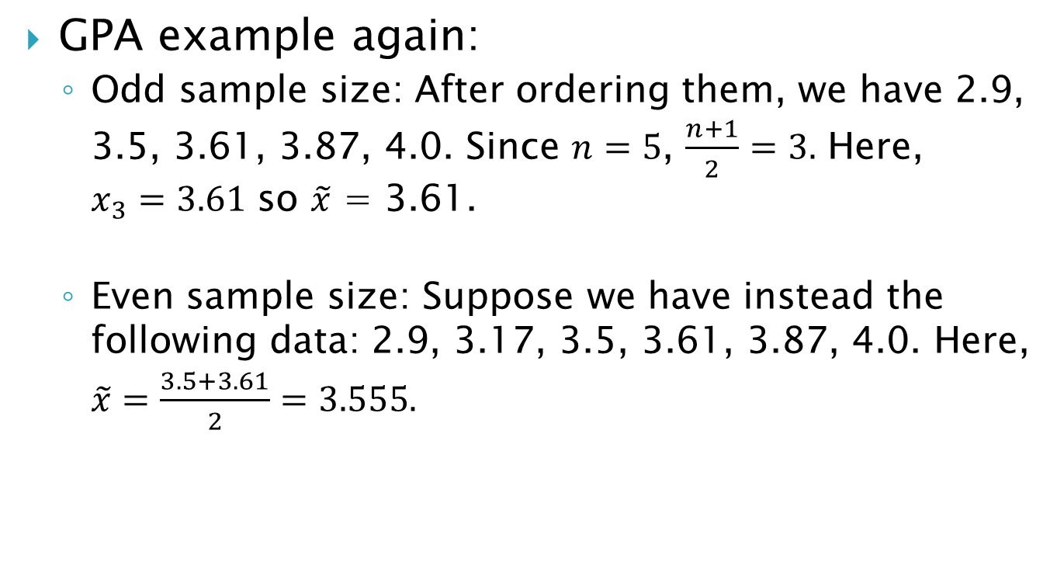
1.3 – Measures of Location
GPA example again:
  Odd sample size: After ordering them, we have 2.9, 3.5, 3.61, 3.87, 4.0. Since $n=5$, $\frac{n+1}{2}=3.$ Here, $x_{3}=3.61$ so $\tilde{x}$ = 3.61.
  Even sample size: Suppose we have instead the following data: 2.9, 3.17, 3.5, 3.61, 3.87, 4.0. Here, $\tilde{x}=\frac{3.5+3.61}{2}=3.555.$

Slide 29
1.3 – Measures of Location
Exercise: Suppose that there are four people in a room with Warren Buffett. The following numbers are the net worth of each individual in the room:
  98000, 139000, 115000, 77100000000
Calculate both the sample mean and the sample median for this data set. Which do you think provides a better measure of the center of the data?

Slide 30
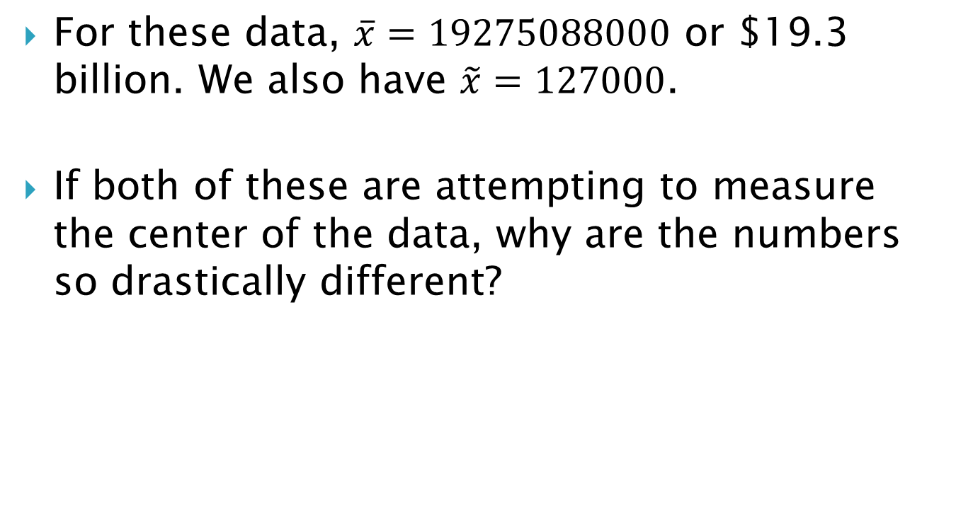
1.3 – Measures of Location
For these data, $\overline{x}=19275088000$ or $19.3 billion. We also have $\tilde{x}=127000$.
If both of these are attempting to measure the center of the data, why are the numbers so drastically different?

Slide 31
1.3 – Measures of Location
The reason the two numbers are so different is because of the outlier.
While it may be difficult to answer, “Which is better?” for a case with only 4 people, suppose we are instead looking at the net worth of all Nebraskans. While the effect will be less dramatic, Warren Buffet’s net worth will still inflate the sample mean. In such a case, using the median will give a better idea of the “true center” of the distribution of Nebraskans’ net worth.

Slide 32
1.3 – Measures of Location
When the mean and median for a data set are dramatically different from one another, this is an indication that there is a problem with outliers. On the other hand, the mean and median being roughly the same is often (though not always) an indication that we don’t have outliers.

Slide 33
1.4 – Measures of Variability
Measures of location are usually considered incomplete without a corresponding measure of variability. The numerical measures of variability we are interested in are variance and standard deviation.
Both of these numbers provide a measure of how spread out the data are. The larger the number, the more spread out the observations are.

Slide 34
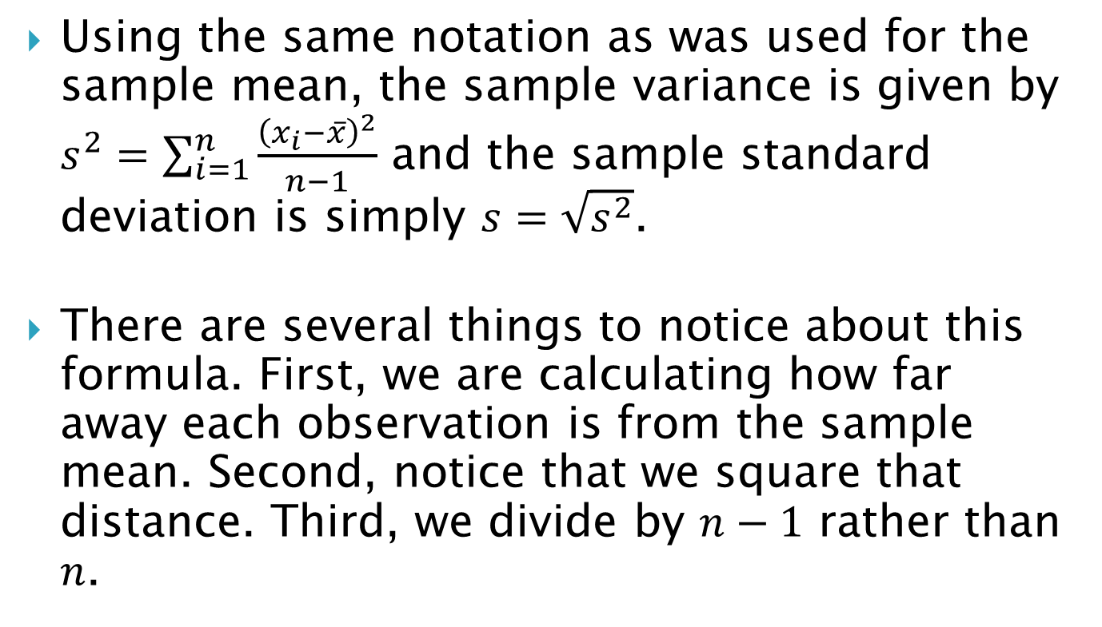
1.4 – Measures of Variability
Using the same notation as was used for the sample mean, the sample variance is given by $s^{2}=\sum_{i=1}^{n}{\frac{{\left(x_{i}−\overline{x}\right)}^{2}}{n−1}}$ and the sample standard deviation is simply $s=\sqrt{s^{2}}$.
There are several things to notice about this formula. First, we are calculating how far away each observation is from the sample mean. Second, notice that we square that distance. Third, we divide by $n−1$ rather than $n$.

Slide 35
1.4 – Measures of Variability
Why do we square the distance?

Slide 36
1.4 – Measures of Variability
Since observations will be on both sides of the mean, we don’t want positive and negative distances to cancel each other out. So we square the distances.
To “repair the damage” done by squaring, we take the square root to calculate the standard deviation. One benefit of the standard deviation is that it is given in the same units as the mean and the observations themselves. This is not the case for variance.

Slide 37
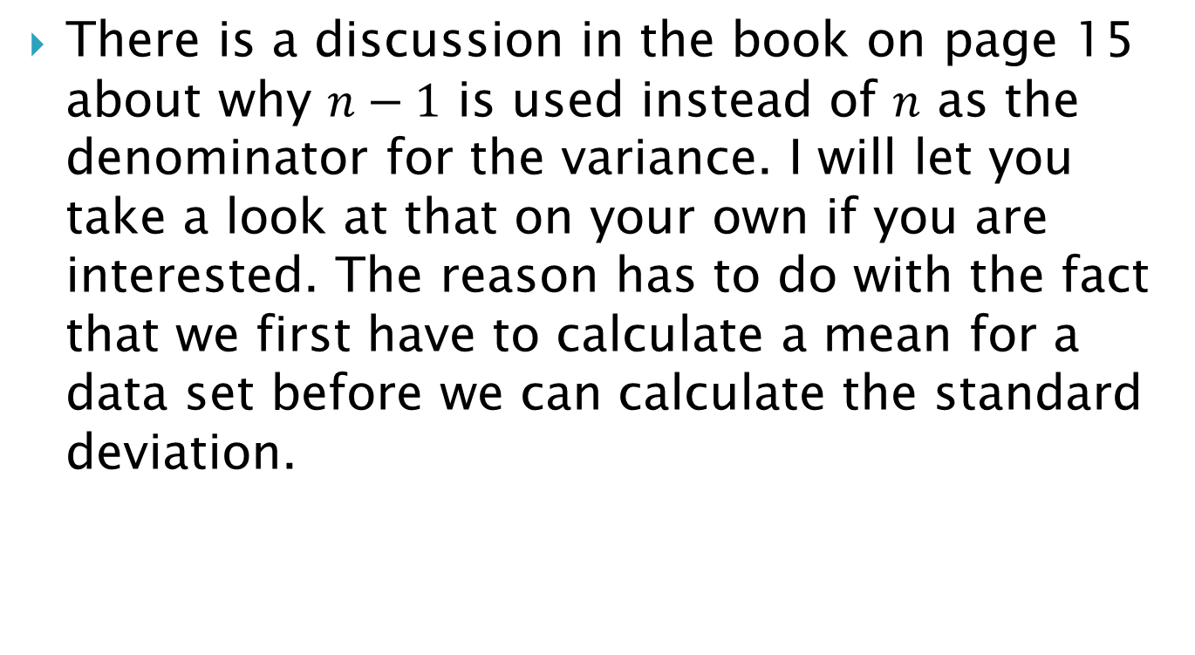
1.4 – Measures of Variability
There is a discussion in the book on page 15 about why $n−1$ is used instead of $n$ as the denominator for the variance. I will let you take a look at that on your own if you are interested. The reason has to do with the fact that we first have to calculate a mean for a data set before we can calculate the standard deviation.

Slide 38
1.4 – Measures of Variability
A final measure of variability is the range. This is simply the largest data value minus the smallest data value.
The range is not used nearly as much as the variance or the standard deviation, but it will come up in a homework problem or two.

Slide 39
1.4 – Measures of Variability
Exercise: The following data set is given on page 15 in the book:
  7.07, 7.00, 7.10, 6.97, 7.00, 7.03, 7.01, 7.01, 6.98, 7.08.
Calculate the variance, standard deviation, and range for this data set (note that you will have to calculate the mean along the way).

Slide 40

1.4 – Measures of Variability
$\overline{x}=7.025$
$s^{2}=\frac{{\left(7.07−7.025\right)}^{2}+{\left(7.00−7.025\right)}^{2}+…+{\left(7.08−7.025\right)}^{2}}{9}=0.001939$
$s=\sqrt{s^{2}}=0.044$
$r=7.10−6.97=0.13$

Slide 41
1.6 – Basic Visualizations
Visualizations are often very useful in helping us understand and draw conclusions from data.
We will briefly cover three basic types of visualizations. You will be asked to make several of these in your homework.

Slide 42
1.6 – Basic Visualizations
The first visualization is the dotplot. This is an extremely simple way to visualize data. All we do is simply plot the values on a number line (usually as dots, hence the name, but you can use whatever symbols you like).

Slide 43
1.6 – Basic Visualizations
The following data are braking distances in feet of 50 cars (measurements were taken in the 1920s):
2 10 4 22 16 10 18 26 34 17 28 14 20 24 28 26 34 34 46 26 36 60 80 20 26 54 32 40 32 40 50 42 56 76 84 36 46 68 32 48 52 56 64 66 54 70 92 93 120 85
While looking at the raw numbers may not tell us much, a dotplot helps us visualize a number of things.

Slide 44
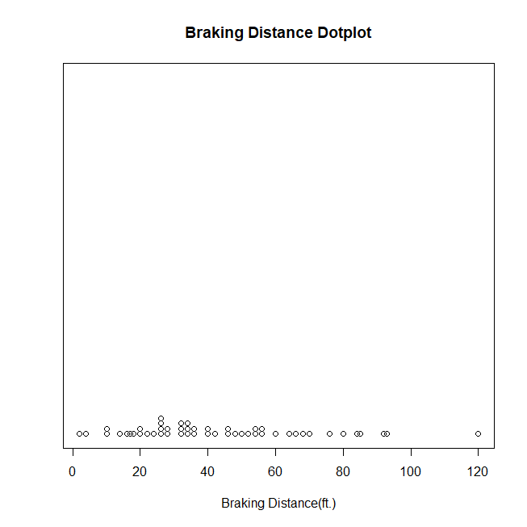
1.6 – Basic Visualizations

Slide 45
1.6 – Basic Visualizations
Where do the data appear to be centered?
How spread out are they? Do you think they have a large or small variance?
We can also use dotplots to compare two or more data sets. If we use a different symbol for each data set, we have an easy way to compare them.

Slide 46
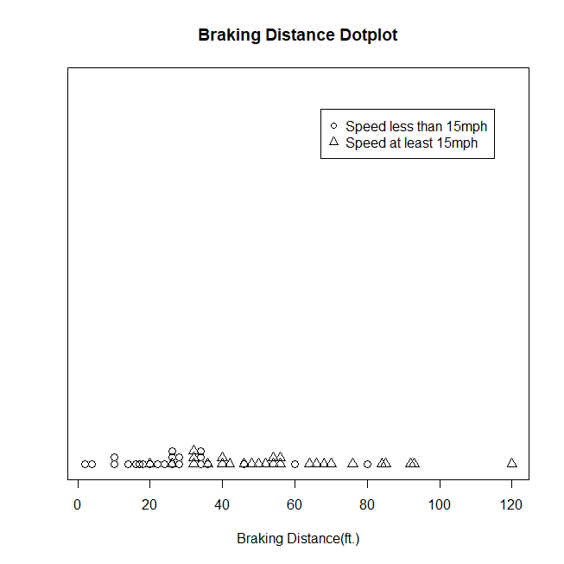
1.6 – Basic Visualizations

Slide 47
1.6 – Basic Visualizations
Where does each data set appear to be centered? Which one has the smaller variability?

Slide 48
1.6 – Basic Visualizations
The next visualization is the histogram. The histogram shows how many observations fall into different intervals (much like a bar graph).
We will focus on a relative frequency histogram. The difference here is that we look at the percentage of data that falls in a given interval.

Slide 49
1.6 – Basic Visualizations
We use the braking distance data again to come up with the relative frequency histogram on the following slide.
Note that the heights of the bars represent the percentage of data that falls in each interval.

Slide 50
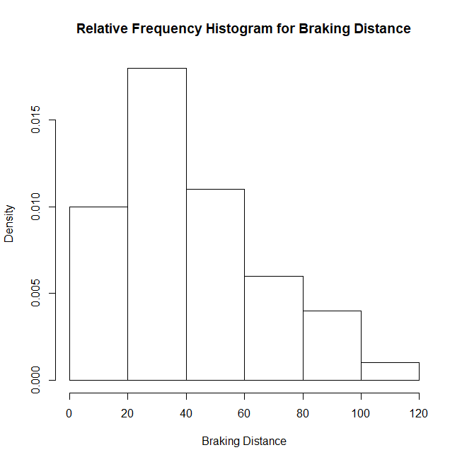
1.6 – Basic Visualizations

Slide 51
1.6 – Basic Visualizations
Once you have the intervals, you simply need to count the number of observations in each interval. These are the frequencies. Then divide each frequency by the sample size. These are the relative frequencies. You draw the histogram bars at the relative frequencies.

Slide 52
1.6 – Basic Visualizations
An easy thing to do is make a table.
Then use the intervals and relative frequencies to make the histogram.
Interval | Frequency | Relative Freq.
1.75-2.24 | 4 | 4/30=0.1333
… | … | …
… | … | …
… | … | …

Slide 53
1.6 – Basic Visualizations
Finally, we look at the scatterplot. The scatterplot is similar to the dot plot. The difference is that each axis has a variable. This is useful for looking at how two variables are related to each other.
The following slide contains a scatterplot where braking distance is plotted on the y-axis and speed is plotted on the x-axis.

Slide 54
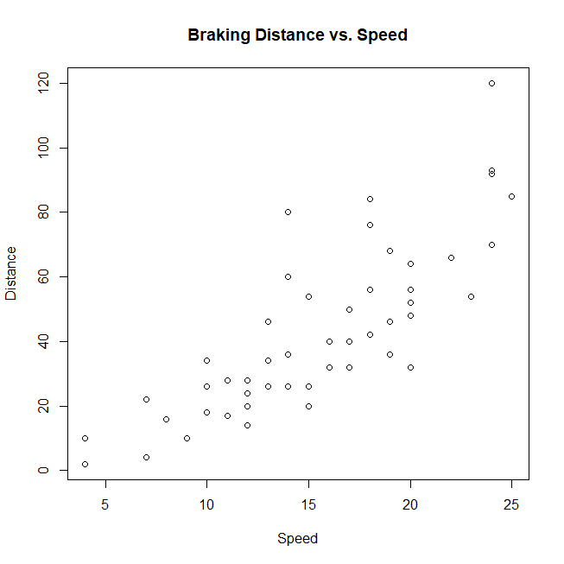
1.6 – Basic Visualizations

Slide 55
1.6 – Basic Visualizations
From the scatterplot, it looks like the variables have a positive relationship. That is, as speed increases, so does braking distance. Furthermore, the relationship appears to be linear with a moderate amount of variability (based on how spread out the points are around a line going through the “middle” of the points).

